Slide 1
How to grow and increase sales for 2023 for Vrinda Stores?
BY: HARISH SREENIVASAN
PERIOD : 2022

Slide 2

Overview
Vrinda Stores a Unisex clothing store having online as well as offline presence.
It exports to various parts of the country
It carters to all age group for men as well as women.
Sales Data is taken for all months for the year 2022.
Tool used for the analysis is Microsoft Excel.

Slide 3
Objective
How to grow and increase sales for the year 2023 by understanding the annual sales report for the year 2022.This analysis can be determined by answering the following question
Which month has the highest sales and order
Who purchased more off the genders
Different order status in 2022
What is the relationship between gender and age
Which are the top sales contributing states
Which channel contributes highest to sales
Which is the highest selling category

Slide 4
Data Cleaning
Each Column was added a filter to search for blank values, and if any discrepancies were also taken note off
Off them, the gender column had two values for the same observant, i.e. male and M for male ,and Women and W for women, so that was synchronized
In the Qty column, a few vales were named as 1 as well as one, and the same was the case for 2, which was filtered and synchronized to form singularity .

Slide 5
Data Processing
A new column was added for categorizing the age based on which category they belong to .
IF condition formula was used to categorize the age group :
Formula:- IF(column,=> 50,“Senior”, IF(Column, =>30,”Adult”,”Teenager”)),
and the formula was applied for the whole column.
A new column was added to determine the month :
Formula:- Text(column,,”mmmm”), and the formula was applied for the whole column.

Slide 6
Data Analysis
A pivot table was added for the data to determine the relationship between the Variables, and thus answer the question up to understand the sales pattern
Pivot tables was generated for a better Visual understanding

Slide 7
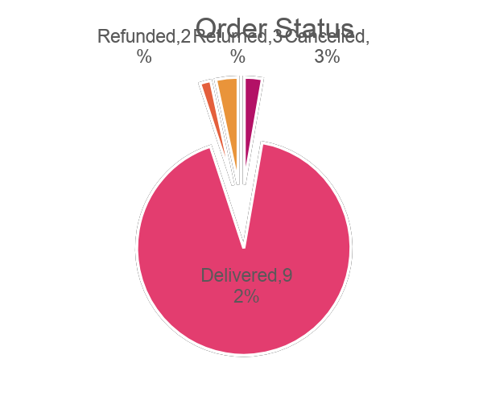
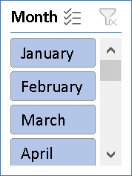
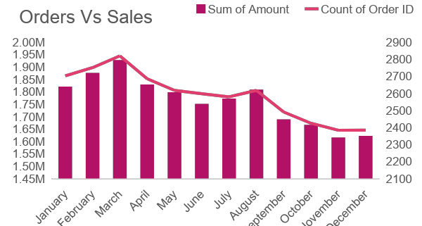
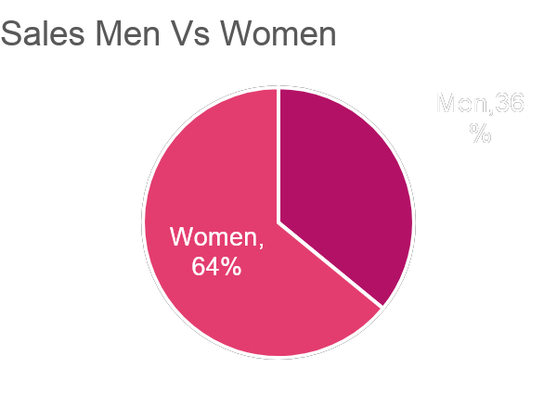
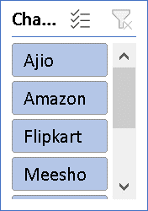
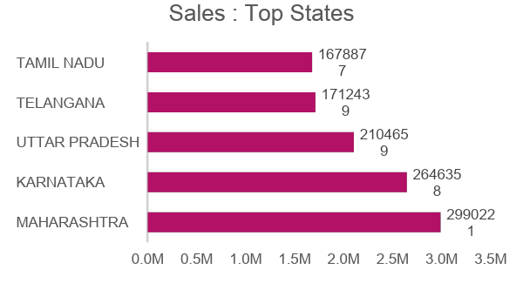
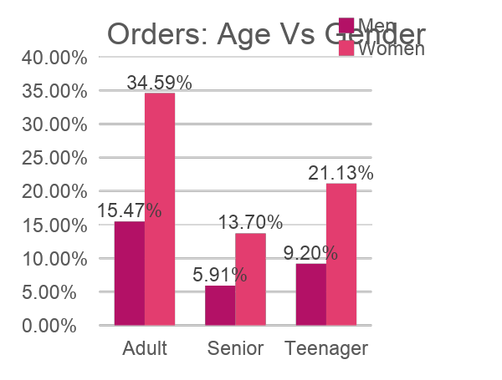
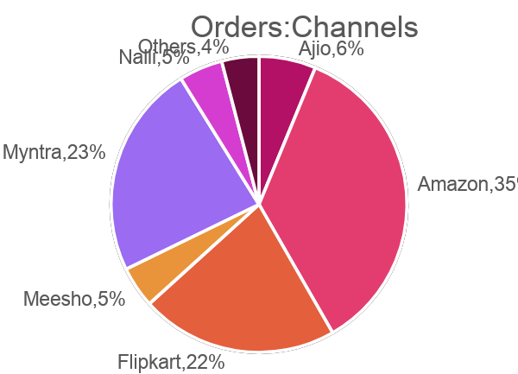
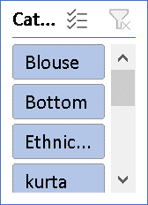
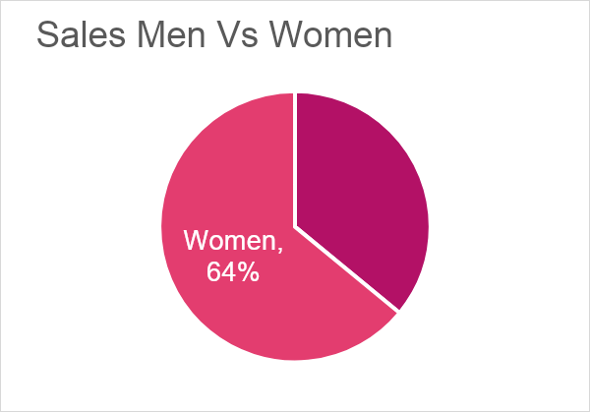
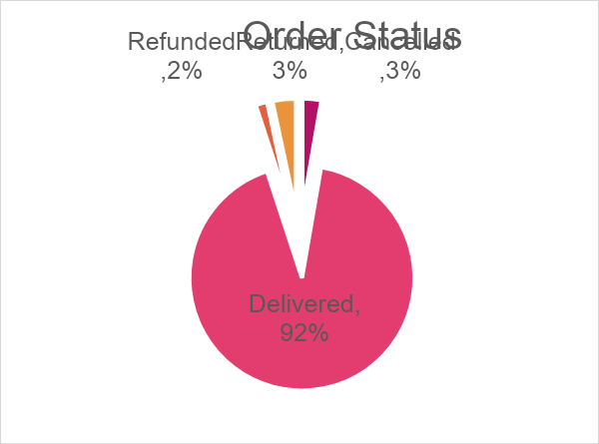
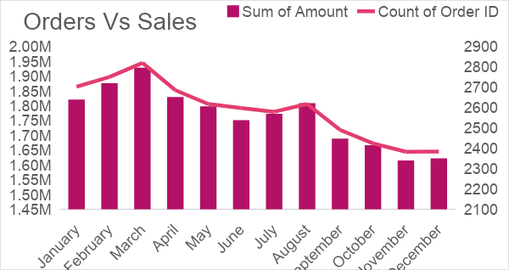
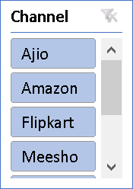
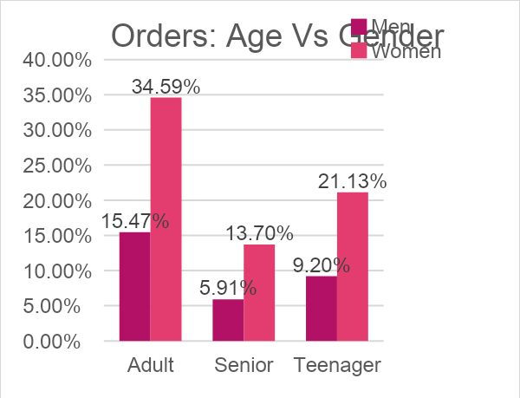
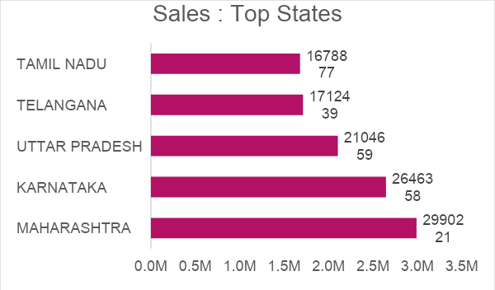
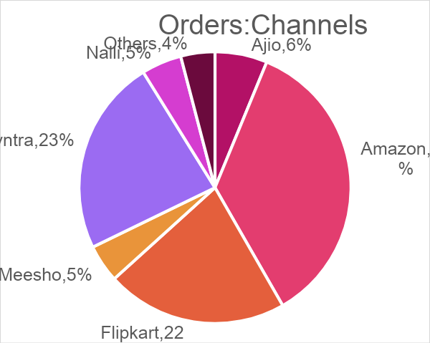
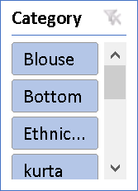
Data Visualization: Vrinda Stores Annual report 2022
Vrinda Store Annual Report 2022
Vrinda Store Annual Resport 2022

Slide 8
Observations
Women have a higher rate of buying
Maharashtra, Karnataka and UP ar the top 3 state for sales
Adult group of (30-49) hold maximum share
Amazon, Flipkart and Myntra channel have highest contribution

Slide 9
Recommendation
Targeting the Women segment with age group of 30-49 who live in Maharashtra, Karnataka and UP , by way of ads/ offers / coupons on sale from Amazon, Flipkart and Myntra can increase the sale for the year 2023.

Slide 10

ThankYou

